Slide 1
Autostereograms and the Deciphering Thereof
Tyler Niles
Spring 2010
ENGG8840

Slide 2
Summary
Proposal:
1. Create a program to Generate stereograms given a grayscale image
2. Create a program to decipher stereograms given a grayscale stereogram
Results:
-Two C programs:
-Generate
-Decode

Slide 3
STEREOGRAM REVIEW

Slide 4
Typical Convergence

Slide 5
Depth Perceived

Slide 6
DECIPHER REVIEW

Slide 7
Shape from Stereo

Slide 8
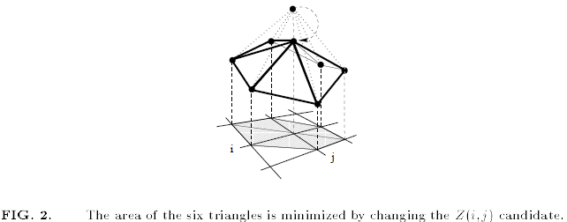
Poorly Written Paper
→ Brute force method

Slide 9
RESULTS
&
DEMO

